Slide 1
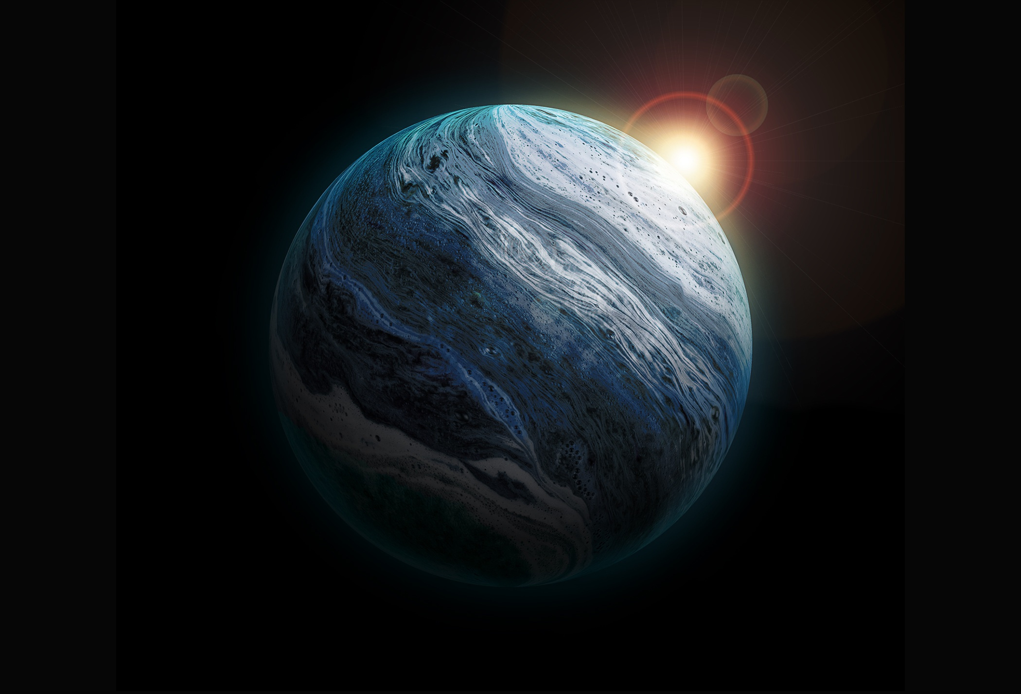
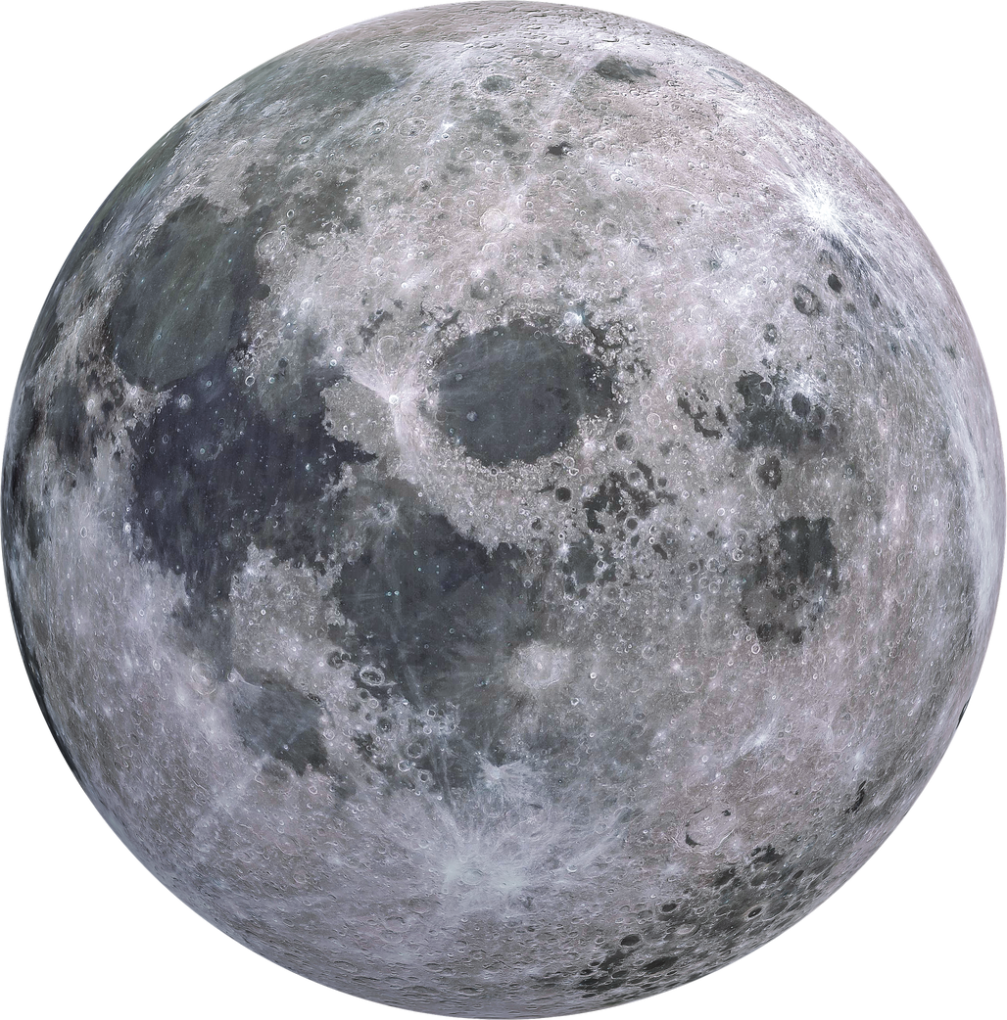

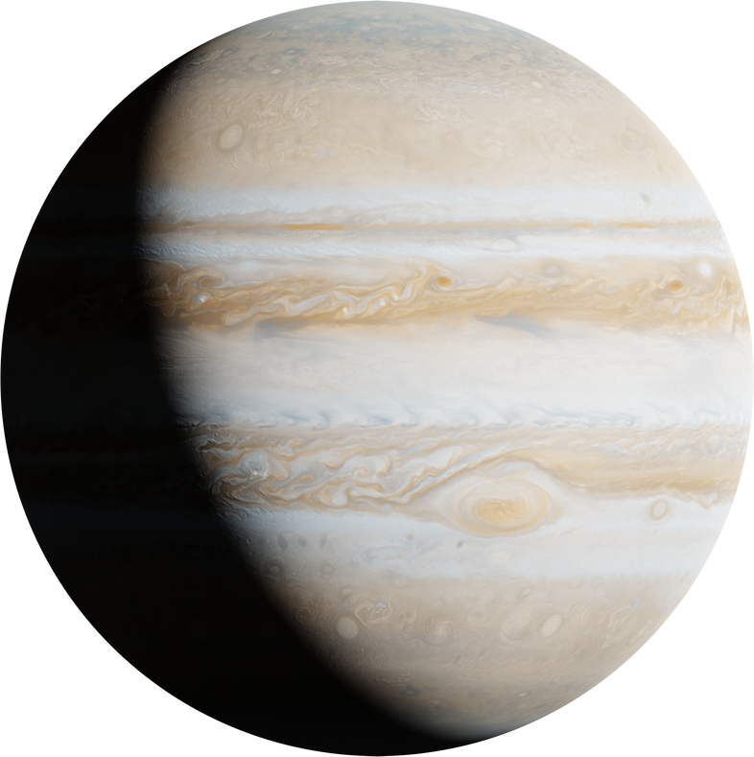
EXOPLANETARY SYSTEMS

Slide 2

Project Description
In this project, we worked with a dataset containing detailed information about stellar bodies, planetary systems, planets and their characteristics. The aim was to create visualizations to explore patterns and relationships within planetary systems.
We planned to analyze features such as planetary sizes, distances, star brightness, and discovery techniques. By visualizing these aspects, we identified key trends, such as the challenges of discovering multiple planets in the same system and the effectiveness of different methods for detecting planets or stars.
The focus was on using data visualization to simplify complex information and gain insights into the dataset. This approach helped us better understand the dynamics of planetary systems and the factors influencing discoveries, providing a clear and visual way to interpret the data.

Slide 3


About Dataset
The dataset from the NASA Exoplanet Archive contains detailed information about discovered exoplanets and their host stars. It includes columns such as planetary properties (mass, radius, orbital period, and semi-major axis), host star characteristics (mass, temperature, luminosity, and metallicity), discovery methods, discovery years, and system distances.
The data also provides insights into multi-planet systems, orbital eccentricities, and equilibrium temperatures, enabling comprehensive analysis. This rich dataset serves as a foundation for visualizing discovery trends, star-planet interactions, habitability factors, and exotic planetary system features, offering valuable insights into the universe's diverse exoplanetary systems.

Slide 4

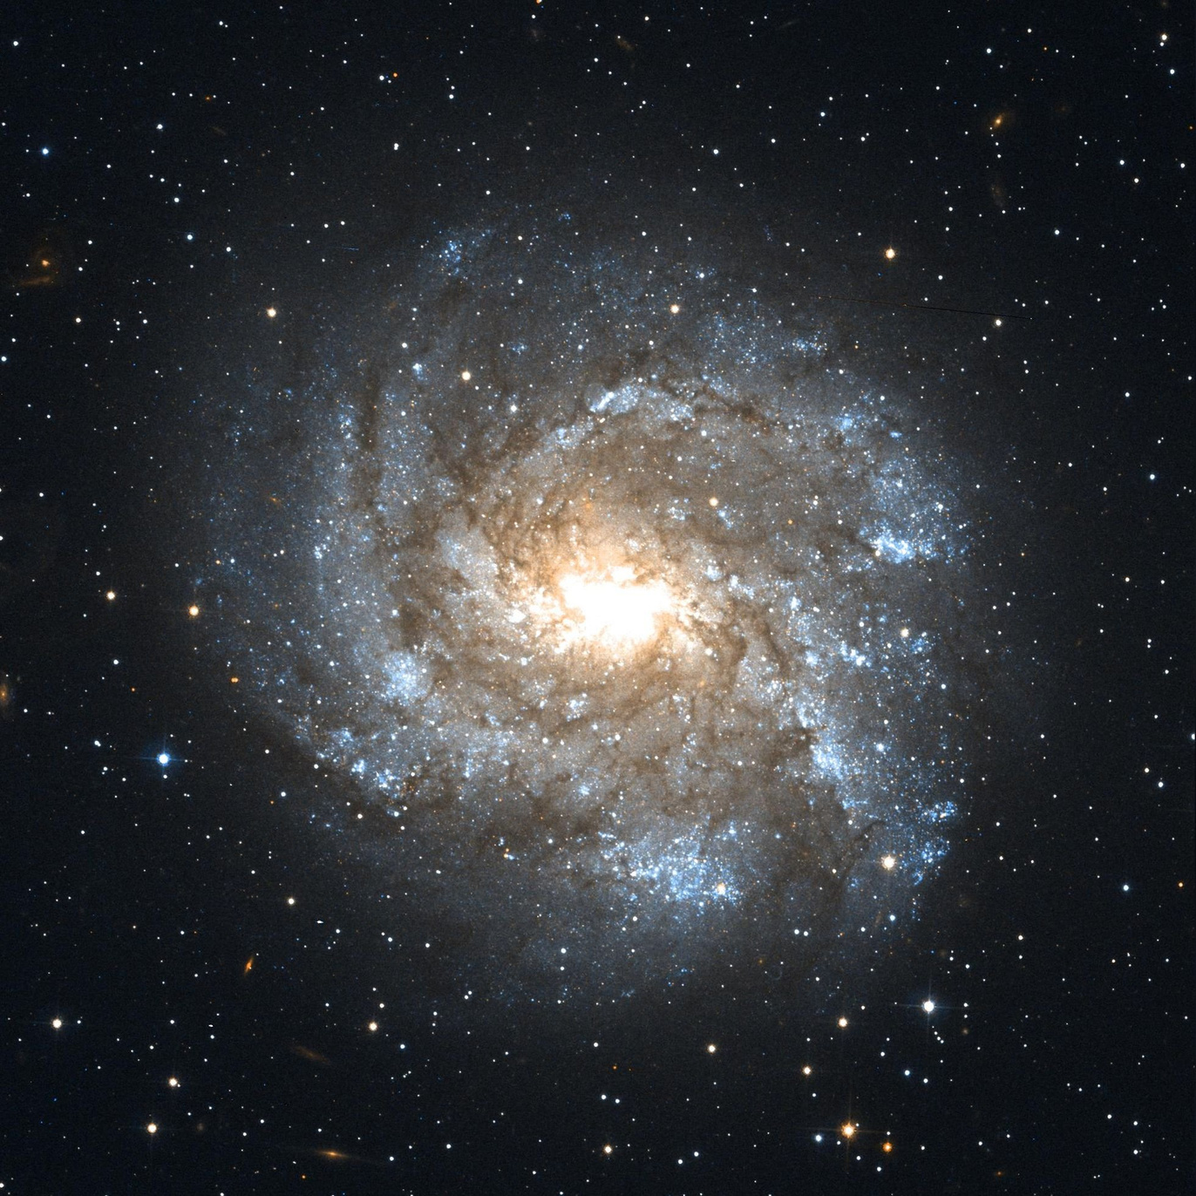
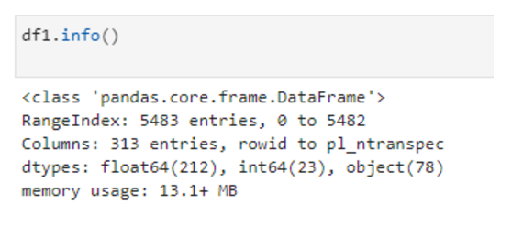
DATASET STATS
We are having 2 datasets (NASA_Exoplanet_Composition and NASA_Exoplanet_Planetary)
01
NASA_Exoplanet_Composition is having 5483 rows and 313 columns

Slide 5

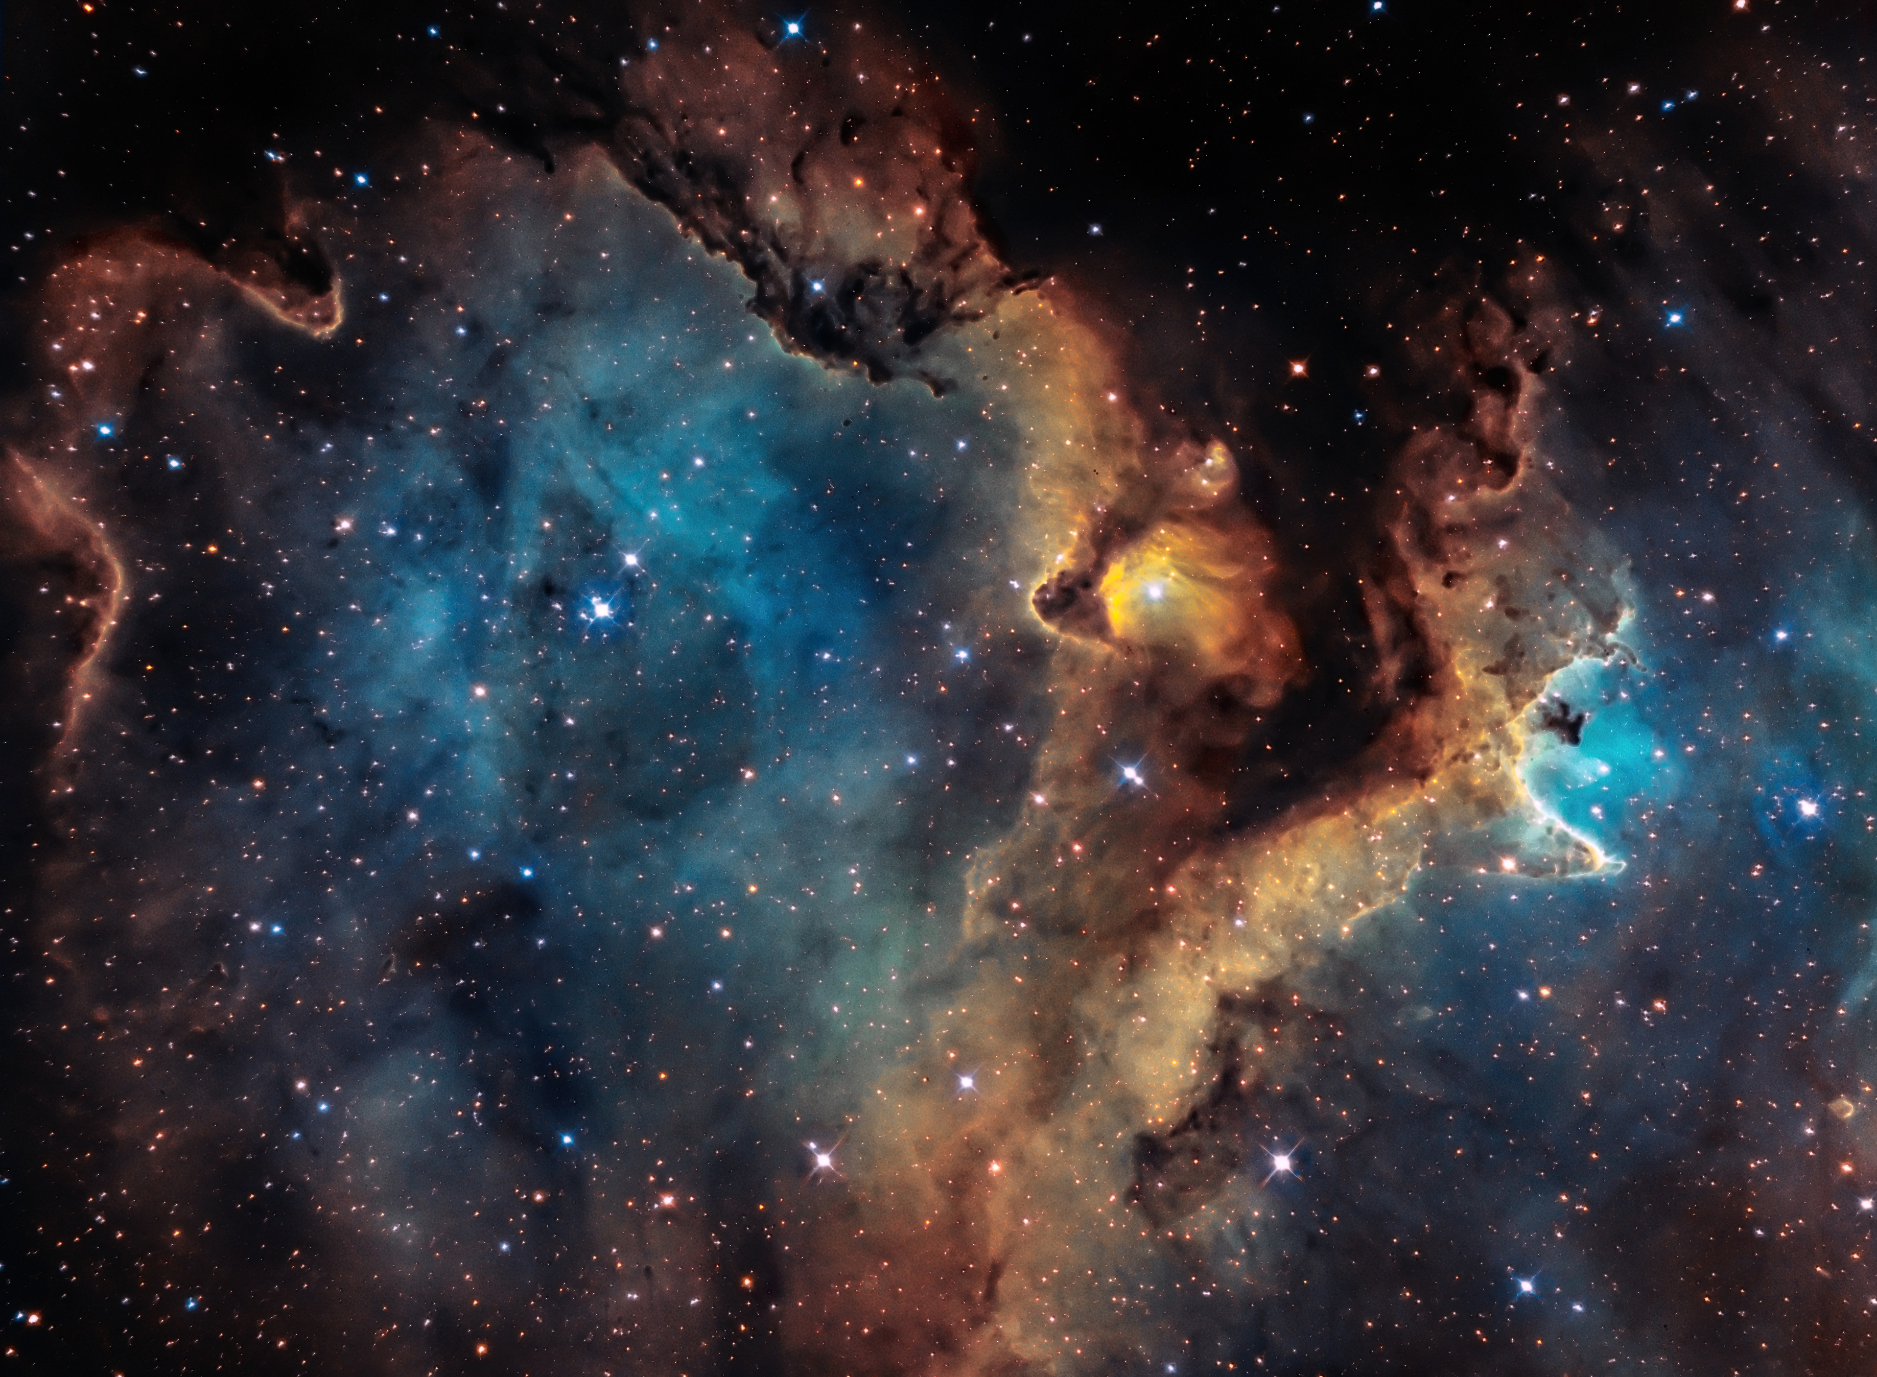
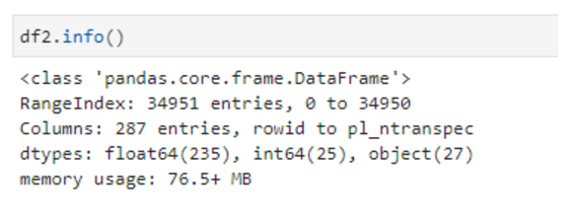
DATASET STATS
We are having 2 datasets (NASA_Exoplanet_Composition and NASA_Exoplanet_Planetary)
01
NASA_Exoplanet_Planetary is having 34951 columns and 287 rows.

Slide 6
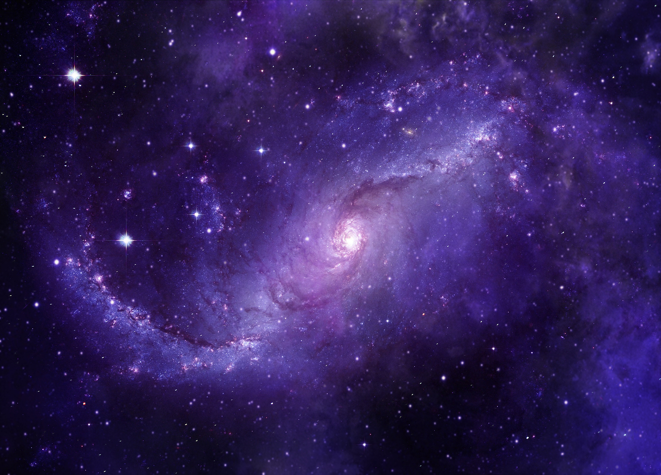

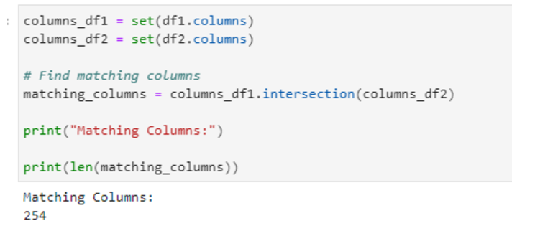
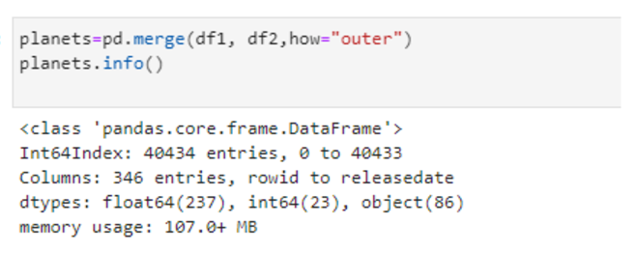
DATASET CLEANING
We got 254 matching columns from both the datasets. And, after merging both datasets
we got 40434 rows and 346 columns in total.
01

Slide 7
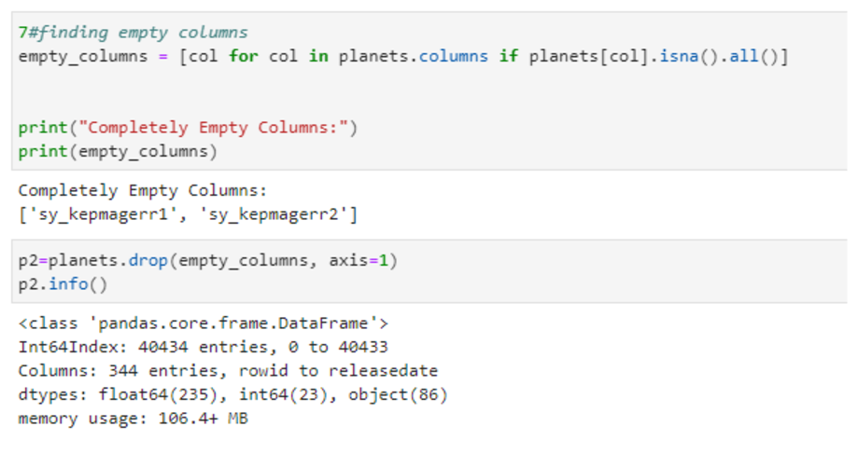
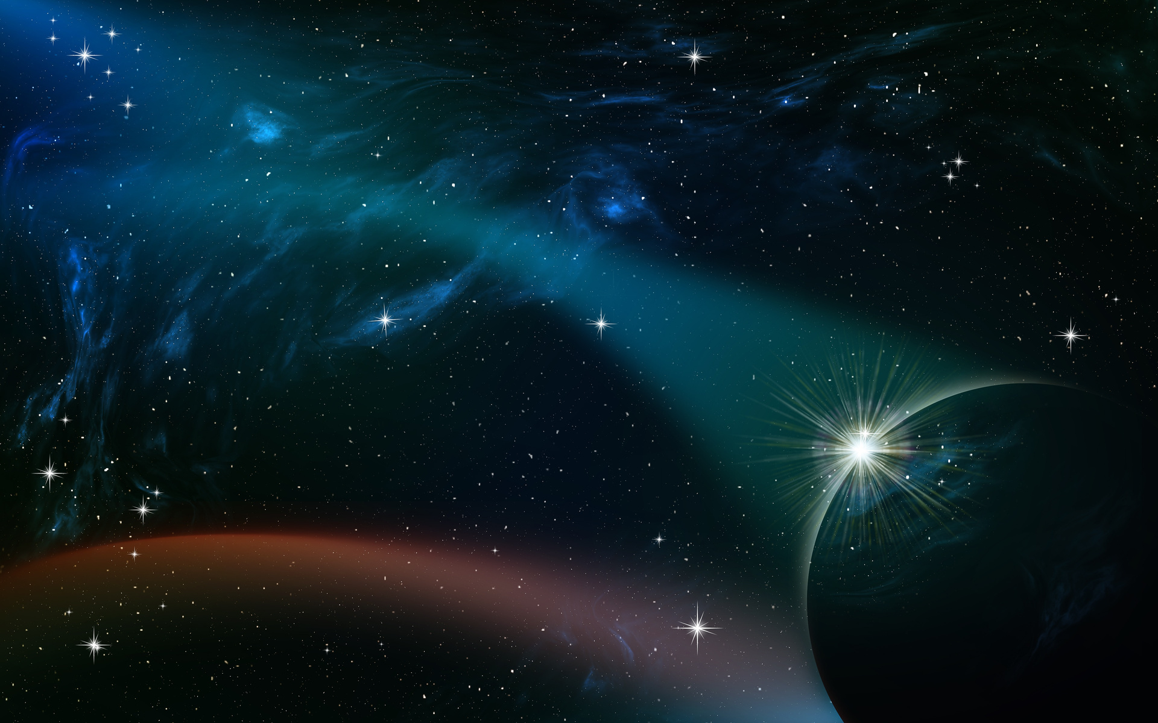
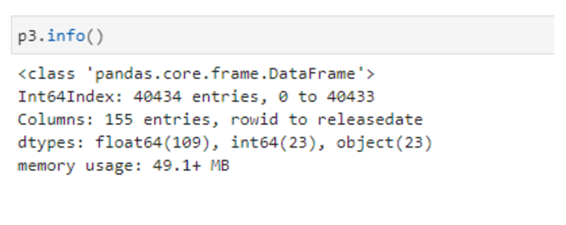
DATASET CLEANING
After removing columns with null values from the planets dataset, we retained 344 columns and 40,434 rows.
From the dataset containing 40,434 rows and 344 columns, we filtered out columns with more than 10,000 null values, reducing the dataset to 155 columns

Slide 8
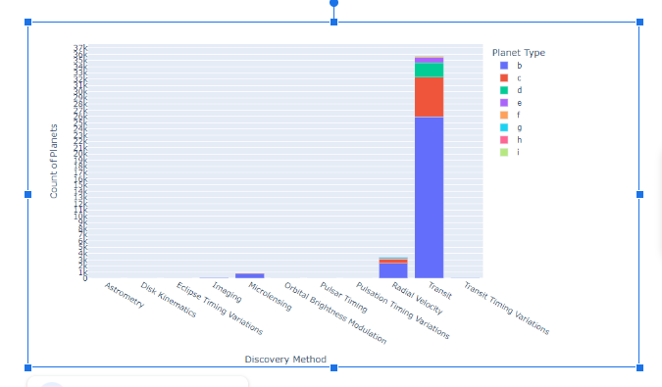
Discovery Methods vs Planet Types
There were 8 planet types (b,c,d,e,f,g,h,i) in our dataset
We identified that more number of planet types were found using the “Transit” discovery method:
Type b planets(25.969K planets found)
Type c planets(6332 planets found)
Type d Planets(2358 planets found)
Type e Planets(784 Planets found)
Type f planets(237 planets found)

Slide 9
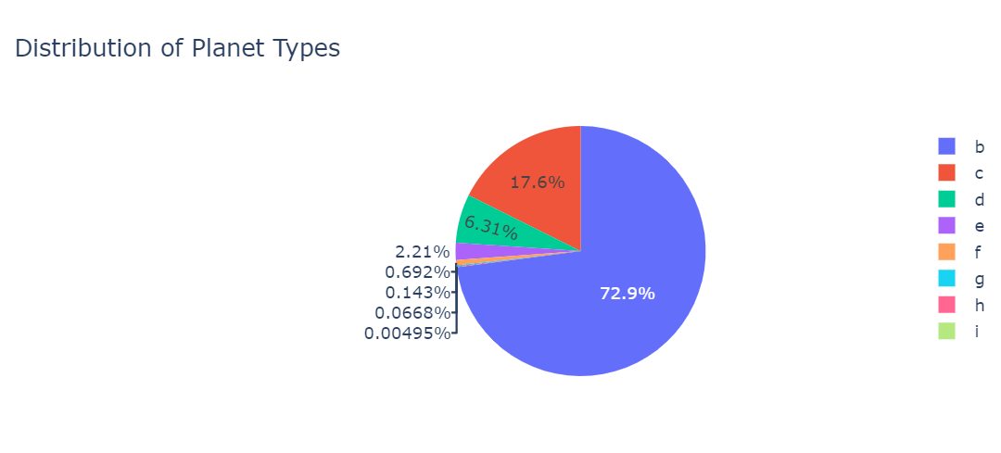
Distribution of discovered Planet types
This plot shows that discovering the first planet (72.9%) in a planetary system is much higher than discovering the second planet in that planetary system and so on. And the percentage of discovery has a steep 100 times drop from the second planet to 5th planet discovery
( 17.6%, 6.31%, 2.21%, 0.692%). From this, we can interpret that the discovery of the first planet is easy from a planetary system but it is difficult to discover any more planets in the same planetary system.

Slide 10
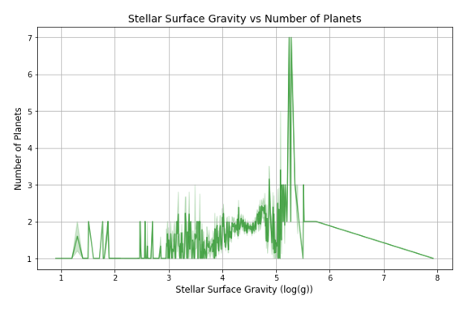
Stellar Surface Gravity vs No. of Planets
From the line plot, we can observe that when the gravitation is too low (1-3) or too high(6-8) the number of planets for those stellar bodies is low, with only a few stars hosting more than 1 planet.
In the medium gravitational range (5-6), a sharp peak in the number of planets can be observed. This reflects optimal conditions for planet formation and retention.

Slide 11
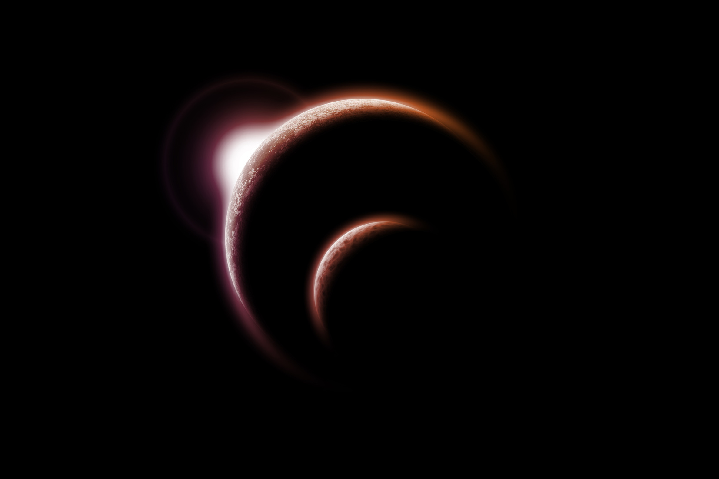
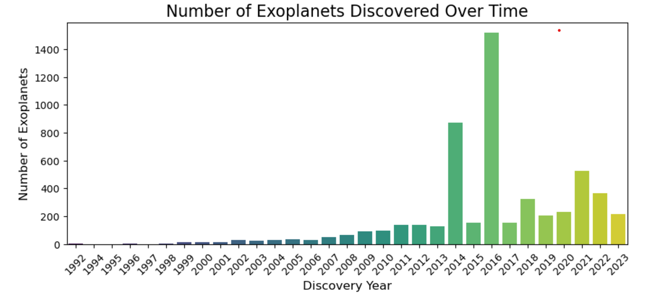
Discovery Trends Over Time
This visualization highlights the growth in exoplanet discoveries and identifies periods of high discovery rates.
From the bar graph, we identified that there were more number of discoveries of exoplanets in the year 2016.

Slide 12
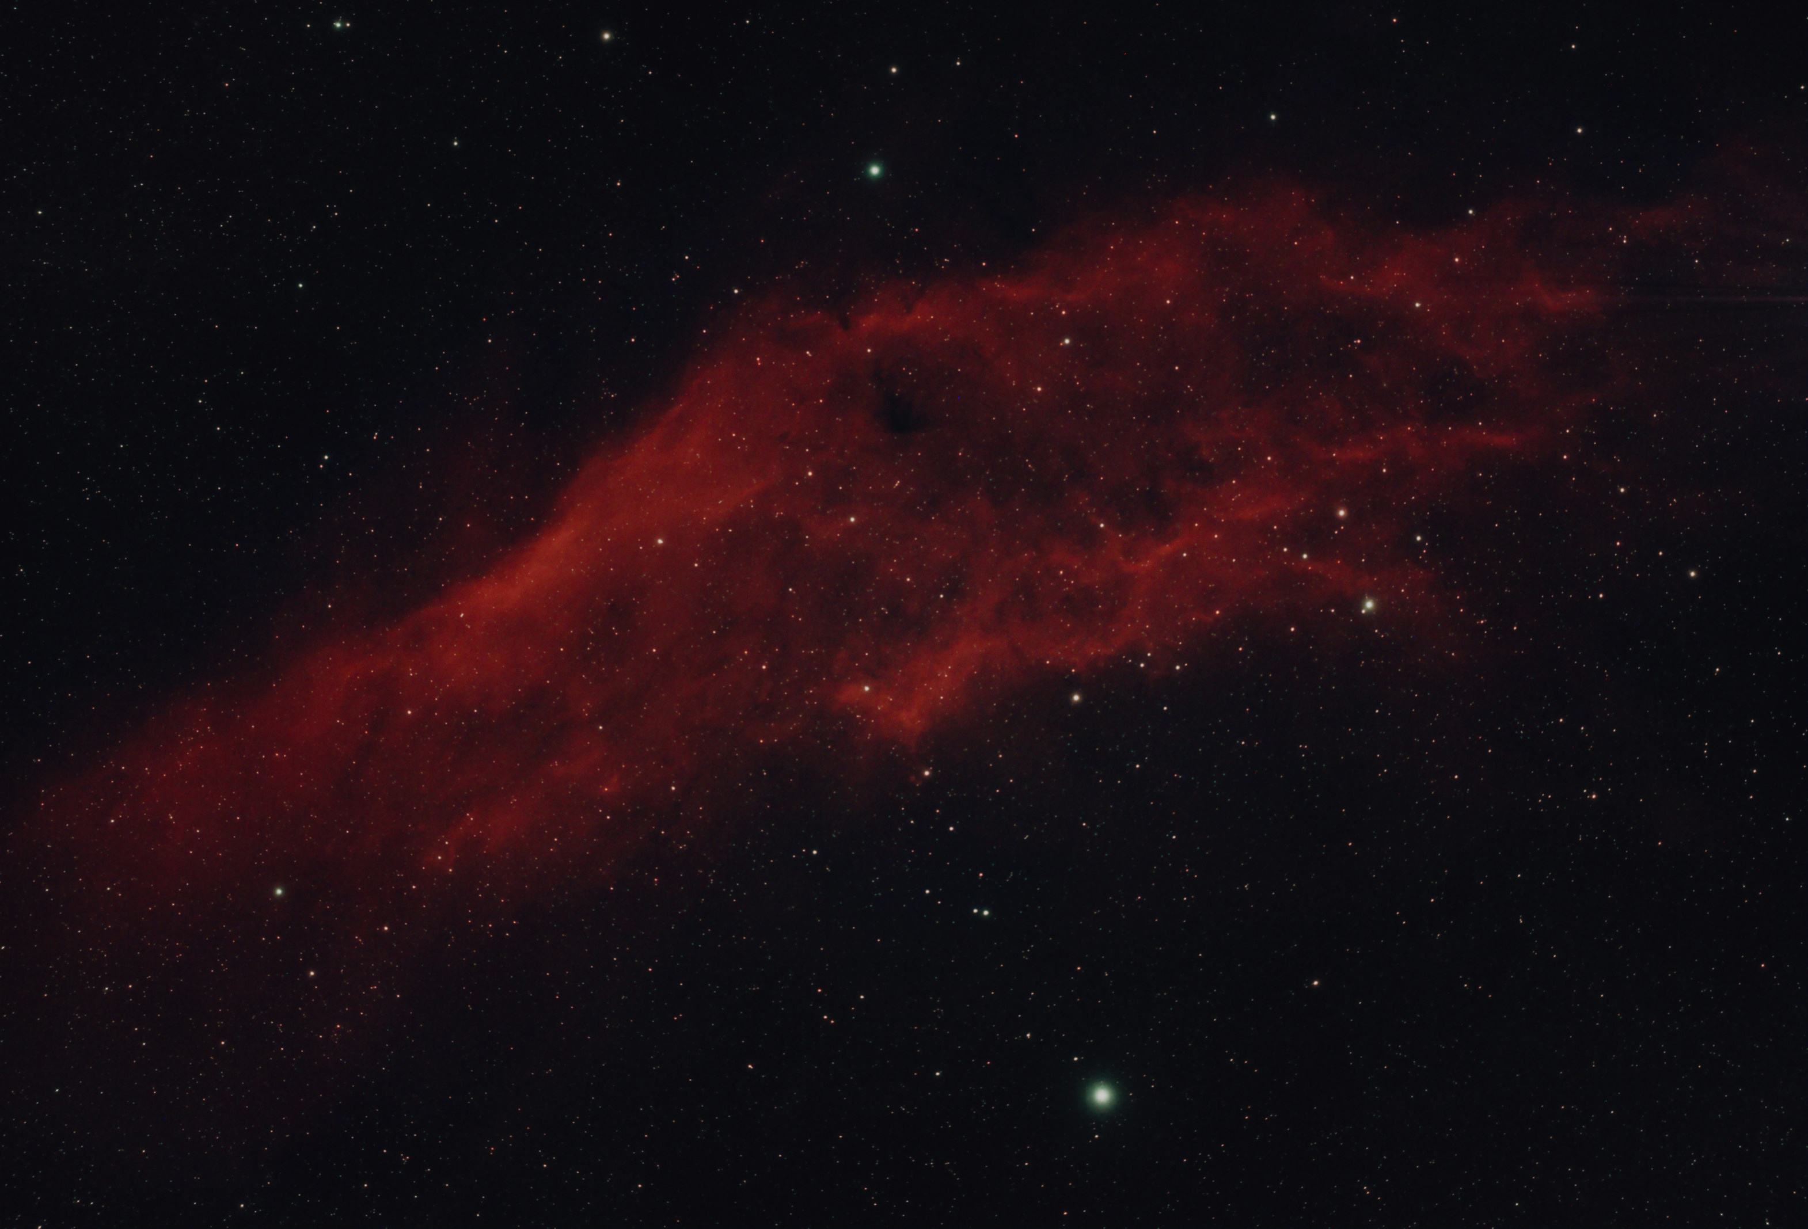
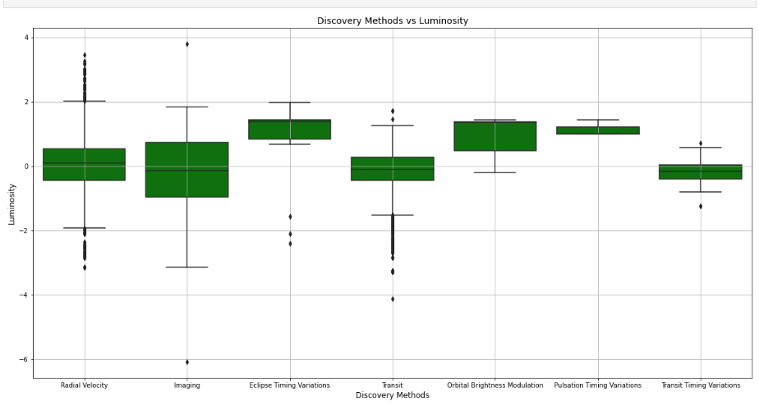
Discovery Method VS Luminosity
From Boxplot, we identified that
Most of the Bright stars are discovered by the “Eclipse Timing Variation” method (so treated as the best method of finding bright stars)
Most of the Dark and Faint Stars are discovered by the “Imaging” method.

Slide 13
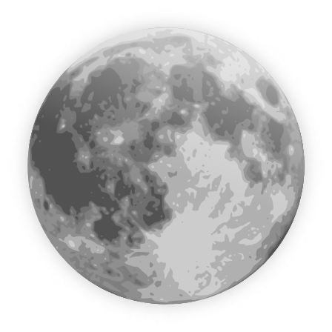

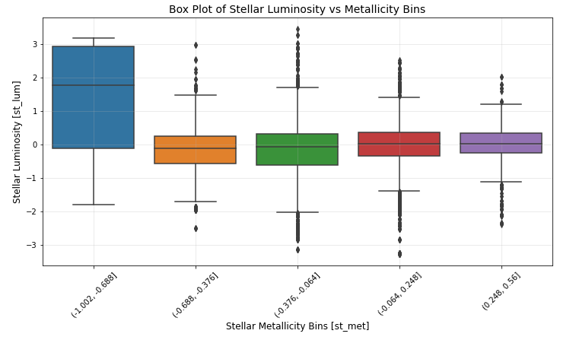
Stellar Luminosity VS Metallicity
By the box plot, we identified that the planets which are having low metallicity are having more luminosity on average.

Slide 14
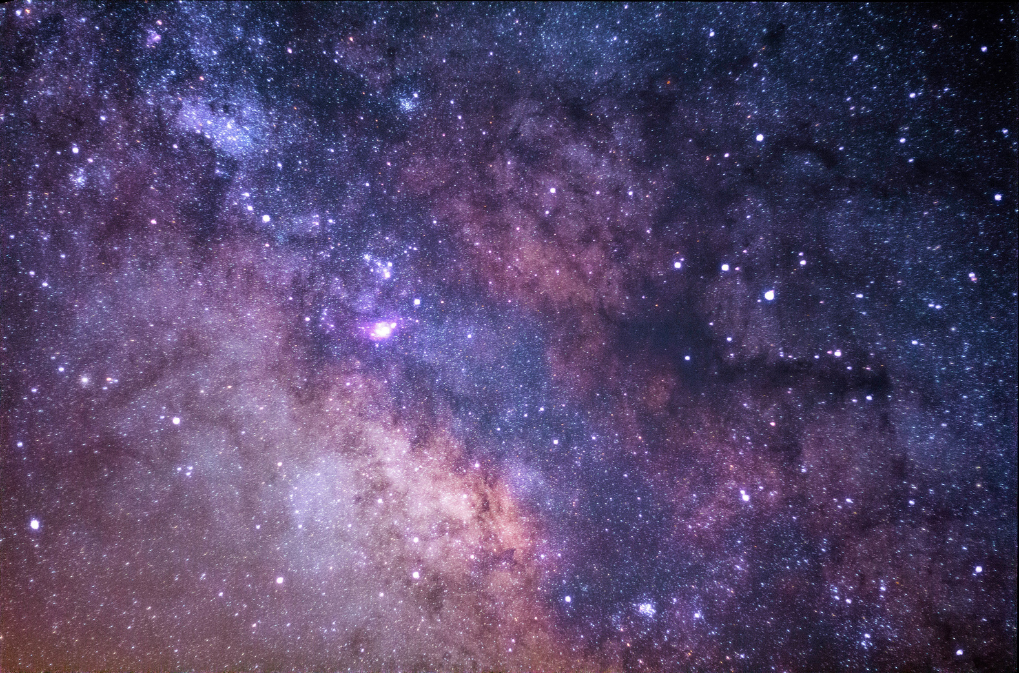


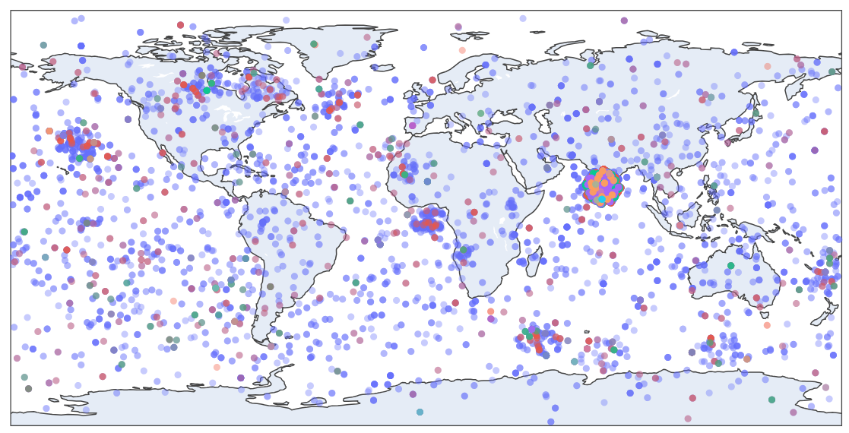
Planet Location around the Earth
This plot shows an interactive plot which shows which planet is located in which direction around the Earth’s surface. The colours of the dots represent the planet type that was discovered. The darker the opacity the more the number of planets are located in that particular direction above the Earth’s surface.

Slide 15

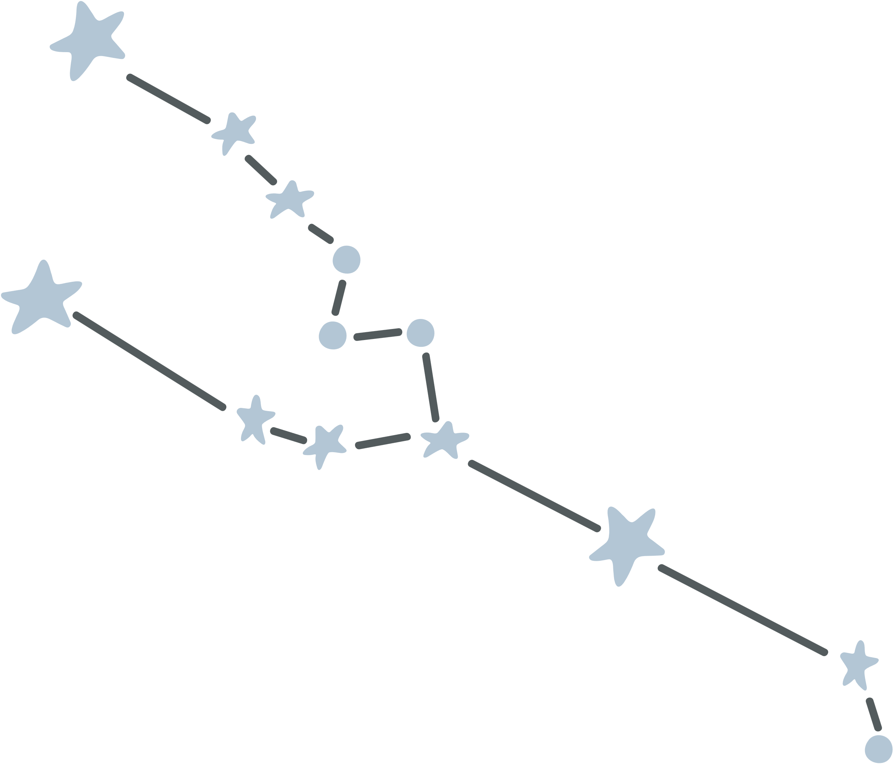
THANK YOU!
Shreya Gupta (2024H1540840P)
Anakari Sravya Hadassa (2024H1540850P)
Kratika Garg (2024H1540855P)
Tarani Satya Kundala (2024H1540861P)

